Slide 1
Assuring Greenhouse Gas Emissions Disclosures - Practitioner Perspectives

Slide 2
Agenda
International developments
Feedback from metrics and targets consultation
How XRB is developing an assurance standard
Specific matters considered:
Assurance report
Ethics and Quality Management
What non-authoritative guidance might be helpful

Slide 3
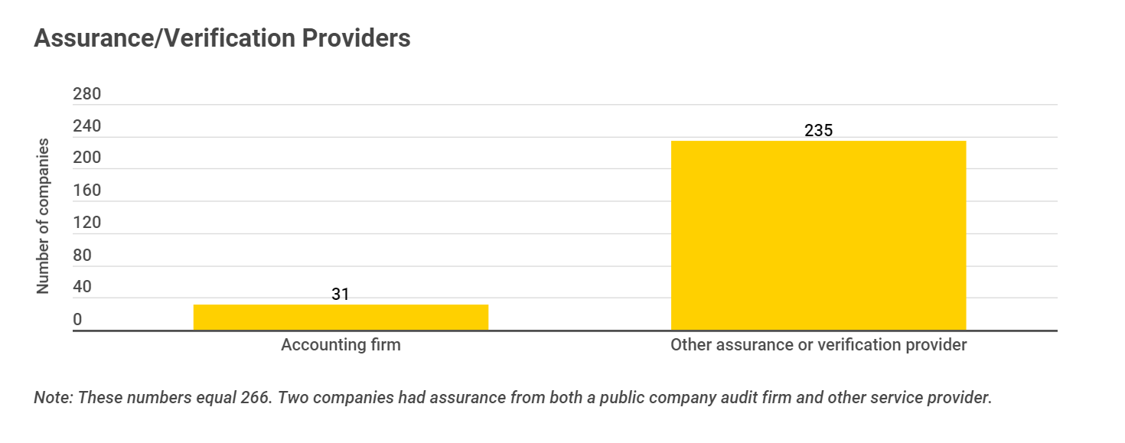
International developments
S&P 500 and ESG Reporting
The state of play in sustainability assurance | Benchmarking global practice
The state of play in sustainability assurance
37%
Audit Firm
Affiliated Firm
Other Service Providers
58%
5%

Slide 4
International developments
Some climate related disclosures to be included in notes to the financial statements (audited by auditor of the financial statement)
Reporting on scope 1, 2 ,3. Phased assurance on Scope 1 and 2 emissions
Do not require GHG assurance to be undertaken by registered accountant
To specify minimum independence and competence requirements​ for an GHG assurance practitioner
SEC Proposals:

Slide 5
International developments
Assurance on sustainability information
Auditor of financial statements prohibited from providing assurance services over the entity’s sustainability information,
An assurance provider is required to comply with requirements that are equivalent to those applicable to statutory auditors (ethics, independence, training, quality assurance, etc.) provided that these requirements result in the same level of assurance quality.
European Parliament proposal:

Slide 6
International Auditing & Assurance Standards Board
Pursue development of standards for assurance on sustainability
Limited v reasonable assurance
Suitable reporting criteria
Scope of engagement
Evidence & Internal Control
Practitioners’ Materiality
Should standard link to ISAE 3000 and/or cover limited and reasonable assurance?
Greenfield approach
Stand-alone standard consistent with ISAE 3000
ISAE 3000 plus approach

Slide 7
International Ethics Standards Board for Accountants
Formed a working group to consider
The “greenwashing”/fraud implications
Whether the Code should be expanded to apply beyond professional accountants
Whether to amend requirements to reflect the importance of independence across to sustainability assurance

Slide 8
Consultation feedback
…what we heard…
Feedback from Strategy and Metrics and Targets consultation
Consultation matter | Summary of feedback
Level of assurance (43 submissions) | Strong support for limited assurance as a starting point Some would like reasonable assurance for Scope 1 and Scope 2 Some respondents consider Scope 3 emissions should be excluded
A summary of feedback is now on our website: https://www.xrb.govt.nz/standards/climate-related-disclosures/strategy-and-metrics-and-targets-consultation-document/

Slide 9
Consultation feedback
…what we are considering…
Scope 3 emissions assurance is challenging:
Need time for methodology and systems to develop (including capability of preparers and quality of data available)
XRB is exploring possible first-time adoption provisions
Example of possible first-time adoption provisions
 | First reporting period | Second reporting period
Reporting | Scope 1 and 2 | Scope 1, 2 and 3
Assurance | No assurance | Limited assurance at a minimum

Slide 10
Question to discuss
2. Concern cannot assure/result in high number of modifications
1. Challenges of scope 3 assurance
Lacking methodology
Data availability and reliability
Specific categories and sectors more challenging
Will disclosure about methodology, uncertainties and any exclusions help?
Would first-time adoption provisions help?

Slide 11
Consultation feedback
…what we heard…
Feedback from Strategy and Metrics and Targets consultation
Consultation matter | Summary of feedback
Metrics and Targets (59 submissions) | Varied feedback on GHG emissions: 40% were supportive of the proposed requirements, 35% suggested amendments or additional disclosures (including to definitions), 15% wanted the XRB to specify a measurement standard (e.g., GHG Protocol or ISO14064), and 10% disagreed with the disclosure requirements. Some queries regarding requirement to prepare a GHG emissions report

Slide 12
…what we are considering…
What is assured and form of conclusion:
Consultation document proposed to mandate the preparation of a GHG emissions report to be an integral part of the disclosures
Some confusion around “integral part of” given it is a separate report
An encouragement from some to think about various scenarios
Where an entity prepares a GHG emissions report
Where an entity includes disclosures in an appendix to climate statement or within the report
Where an entity voluntarily seeks assurance over more than GHG emission disclosures
Public sector reporting
We heard

Slide 13
…what we are considering…
What is subject to assurance, what is the engagement, what is the conclusion
XRB set the disclosure standard (not a measurement standard) for GHG emissions
What disclosures are needed about GHG emissions (from a user perspective and to enable assurance)
Proposing disclosure of specific information relating to measurement standard used e.g., specific exclusions of sources, facilities and/or operations
Proposing disclosure of significant methodologies, assumptions and estimation uncertainty
Is an emissions report necessary in all circumstances?

Slide 14
Proposed disclosures subject to assurance
Disclosure of specific information relating to measurement standard used e.g., specific exclusions of sources, facilities and/or operations
Scope 1, 2 and 3 GHG emissions
Disclosure of significant methodologies, assumptions and estimation uncertainty

Slide 15
Possible assurance opinion
Limited Assurance Conclusion
Based on the procedures we have performed and the evidence we have obtained, nothing has come to our attention that causes us to believe that ABC’s GHG emission disclosures (in note X on page Y of the Climate Statement) for the year ended 31 December 20X1 are not prepared in all material respect, in accordance with NZ CS 1, measured in accordance with [recognised measurement criteria such as Greenhouse Gas Protocol Corporate Standard], consistent with our assurance conclusion on the GHG Emissions Report.

Slide 16
Question to discuss
1. Thoughts on replacing emissions report with:
Measure in accordance with recognised standard
Disclosure requirements relating to methodology, uncertainty, exclusions?
Reporting in an assurance report
2. Reactions to indicative conclusion

Slide 17
Developing the XRB assurance standard
ISAE /ISO have high level of alignment
Desire to align with international standards
Changing landscape
Expect expansion of assurance to extend to full climate statement
Oversight and regulation of assurance practitioners to be determined
Interim solution - Ideas under consideration
XRB assurance standard that allows use of either ISAE (NZ) or ISO
Bridge between ISAE and ISO
Notes:
How are we developing the standard – mindful that there is a legislative requirement for compliance with assurance standards issued by the XRB
At the last session – objective of one standard accessible to all, fit for purpose
We have undertaken a comparison of the ISAEs and ISOs (learning about a whole other assurance framework)
At the engagement level , these standards have informed each other over time – high level of alignment
What we have heard so far from practitioners is not to reinvent the wheel – i.e. please don’t create a NZ specific standard – strong desire to retain alignment with international….challenge is that there are two sets of well established and recognised international standards.
Our objectives are ambitious – to try to bring together two worlds. And we have been looking at various approaches
Our focus to date has been on if and how we can bridge the standards without creating barriers - exploring whether we can start from the extant XRB 3410 standard, and then adjust to add some ISO enhancements and also if and how to make the terminology more accessible to all. So that is one option however we have concerns that this will still be a barrier for those not currently applying 3410.
We also acknowledge that the environment is fluid – what GHG information will be assured is still under construction…..and at the same time we know some are already seeking voluntary assurance over more than GHG . The oversight and regulation of the assurance practitioner is also still under construction.
So another option is that we recognise the need for an interim solution

Slide 18
Assurance report considerations
Area | Matters explored
Scope | Scope 3 emissions and transitional provisions
Level of assurance | Mixed levels of assurance How much detail to report so users understand level of assurance
Legislative requirements | Voluntary assurance broader than GHG emission disclosures
Long form reporting/ key assurance matters | Highlight uncertainty in the reporting Highlight data quality Procedures performed Description of responsibilities
Materiality | Should the assurance report disclose materiality?
Consistency | Order, terminology, headings (Emphasis of matter/qualified or modified opinion) Reference to ethical and quality requirements Disclosure of any relationships or other services provided/fees/tenure

Slide 19
Question to discuss
1. Thoughts on assurance report:
Prescriptive versus flexible for consistency

Slide 20
Ethics and Quality Management
Ethics, independence and quality management are fundamental
Respect other assurance practitioner’s ethical and quality management frameworks
Interim solution may be principle-level requirements (not necessarily extant XRB standards)
Independence/Impartiality precludes an assurance practitioner from “assuring” their own work

Slide 21
Key Ethical Principles
Non-compliance with laws and regs
Independence
Fundamental Principles and Conceptual Framework
Role and Mindset
Pressure
Acting with sufficient expertise

Slide 22
Fundamental principles
Integrity
Be straightforward and honest in all professional and business relationships.
Objectivity
To exercise professional or business judgement without being compromised
Professional Competence and Due Care
Apply an appropriate level of professional knowledge, skill and diligence
Professional Behaviour
Comply with laws and regs, act in the public interest and don’t discredit the profession
Respect confidentiality of information acquired as a result of professional and business relationships.
Confidentiality

Slide 23
Conceptual Framework
Exercise professional judgement
Identifying Threats
Evaluating Threats
Addressing Threats
Reasonable and informed third party test
Have an inquiring mind

Slide 24
Threats
1
Self-interest – What’s in it for me and does this impact my decision making?
2
Self-review – Am I reviewing my own work or evaluating recommendations I previously made?
3
Advocacy – Am I at risk of promoting my client’s position in a way that is inappropriate?
4
Familiarity – Does my long-standing relationship with my client threaten my decision-making or judgement?
5
Intimidation – Do I feel threatened in any way with respect to performing my job in a diligent, professional or objective way?

Slide 25
Independence
Prohibitions to explore
Consultancy
Assuming the role of management
Independence:
in mind
in appearance/ perception
Organisation and engagement team member

Slide 26
Question to discuss
1. Thoughts on key principles:
Fundamental principles
Conceptual framework approach
Threats
2. Thoughts on independence
perception and actual

Slide 27
Guidance
What non-authoritative guidance might be helpful?
Limited vs reasonable assurance
Education of users
Auditing Other information (including the climate statement)
Using work of others

Slide 28
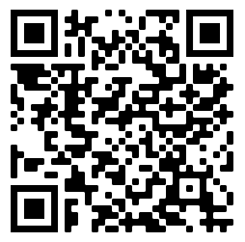
linkedin.com/
company/
external-reporting-board
Follow
Discover
Subscribe
https://www.xrb.govt.nz/sign-up/
Contact
us
assurance@xrb.govt.nz
Questions?

