Slide 1
Housekeeping
We recommend using the side-by-side view.
Please keep your video off and remain on mute if you are not speaking.
Use the hand up function, if you wish to ask a question and provide comments.
You can leave your comments also in chat.
Slides will be made available after the presentation.
Thank you for joining us today,
Enjoy the presentation.
Thank you for joining us today,
Enjoy the webinar.

Slide 2
Assurance Engagements over GHG Emissions Disclosures
Feedback forum
8 February 2023
Notes:
Kia Ora and welcome to our feedback forum
In December we issued the outcome of months of work so you know have a copy of the proposed wording for what the requirements for assurance engagements will look like.
Today is one way in which you can provide us with your feedback on the proposed wording which is on our website.
This is a feedback forum – we encourage active participation. We will be using polls, and the chat, and we created this as a meeting so that you are able to raise your hand and make a comment or question. No need to wait until the end – but please do raise your hand and we will call on you to put your mic and or camera on to do so. We are a friendly bunch so please don’t be shy – my experience is that on this topic there is likely to be a lot of discussion. We are also not recording this session to encourage you to make your comments. But be best rest assured we are taking copious notes and all comments questions and suggestion raised today will be captured and considered.

Slide 3
Assurance Engagements over GHG Emissions Disclosures
Agenda
GHG Assurance team
Misha Pieters
Context
Objectives in developing proposals
Key features of the proposed standard
Director – Auditing and Assurance
Karen Tipper
Technical Director – Auditing and Assurance
Anna Herlender
Project Manager – Auditing and Assurance
Notes:
Our agenda for the hour is
I am joined by Anna Herlender and Karen Tipper who has just joined the assurance team at the XRB.

Slide 4
Climate disclosures in New Zealand
Climate-related disclosure framework: Aotearoa New Zealand Climate Standards
Aotearoa New Zealand Climate Standard 2:
First-time Adoption of Aotearoa New Zealand Climate Standards
(NZ CS 2)
Aotearoa New Zealand Climate Standard 1:
Climate-related Disclosures (NZ CS 1)
Aotearoa New Zealand Climate Standard 3:
General Requirements for Climate-related Disclosures (NZ CS 3)
4
Notes:
Lets start with some context:
The XRB issued the Aoteroa NZ climate statements in December and we hope that climate reporting entities are now busy preparing for this new regime. Reporting is mandatory from 1 Jan 2023
Climate-related disclosures are mandatory for large, listed companies; large-licensed insurers, registered banks, credit unions, building societies and managers of investment schemes with more than $1 billion in assets.
There are three standards making up the framework.
First, NZ CS 1. This is where the main four dislcosure areas (Governance, Strategy, Risk Management and Metrics and Targets (which include the greenhouse gas emissions) are housed. It also identifies the scope of the mandatory assurance that is required over GHG emissions disclosures.
NZ CS 2 provides a limited number of first-time adoption provisions
– an entity can choose which adoption provisions it wishes to use.
Then we have NZ CS 3. This is a very important standard, as it houses both the principles for disclosure, and the general requirements including requirements for disclosure of methodoligies, assumptions and uncertainties.

Slide 5
What has to be assured and by who
The assurance engagement covers:
GHG emissions: gross emissions in metric tonnes of CO2e classified as: scope 1, scope 2, scope 3
Additional requirements – statement of standards, consolidation approach, exclusions
GHG emissions methodologies, assumptions and estimation uncertainty
Assurance practitioner:
Independent
Competent
Notes:
But this forum is about assurance not reporting so lets remind you what has to be assured…
Legislation requires that assurance engagements are undertaken for GHG emissions included in climate statements. This assurance engagement must be undertaken in accordance with the XRB’s standards. This assurance is mandatory from Oct 2024. This allows one year grace period.
As a reminder the assurance must cover the following disclosures required by the XRB’s climate standards:
the disclosed gross scope 1, 2 & 3 emissions,
any additional disclosures around standards used, consolidation approach and exclusions
as well as the required disclosures around methodology, assumptions and estimation uncertainty
Legislation does not specify who can provide assurance engagements. However, it does specify that an assurance practitioner will need to apply all relevant assurance and auditing standards issued by the XRB. Our proposed standard requires that an assurance practitioner undertaking the GHG assurance engagement must be independent and competent in both assurance and GHG emissions.

Slide 6
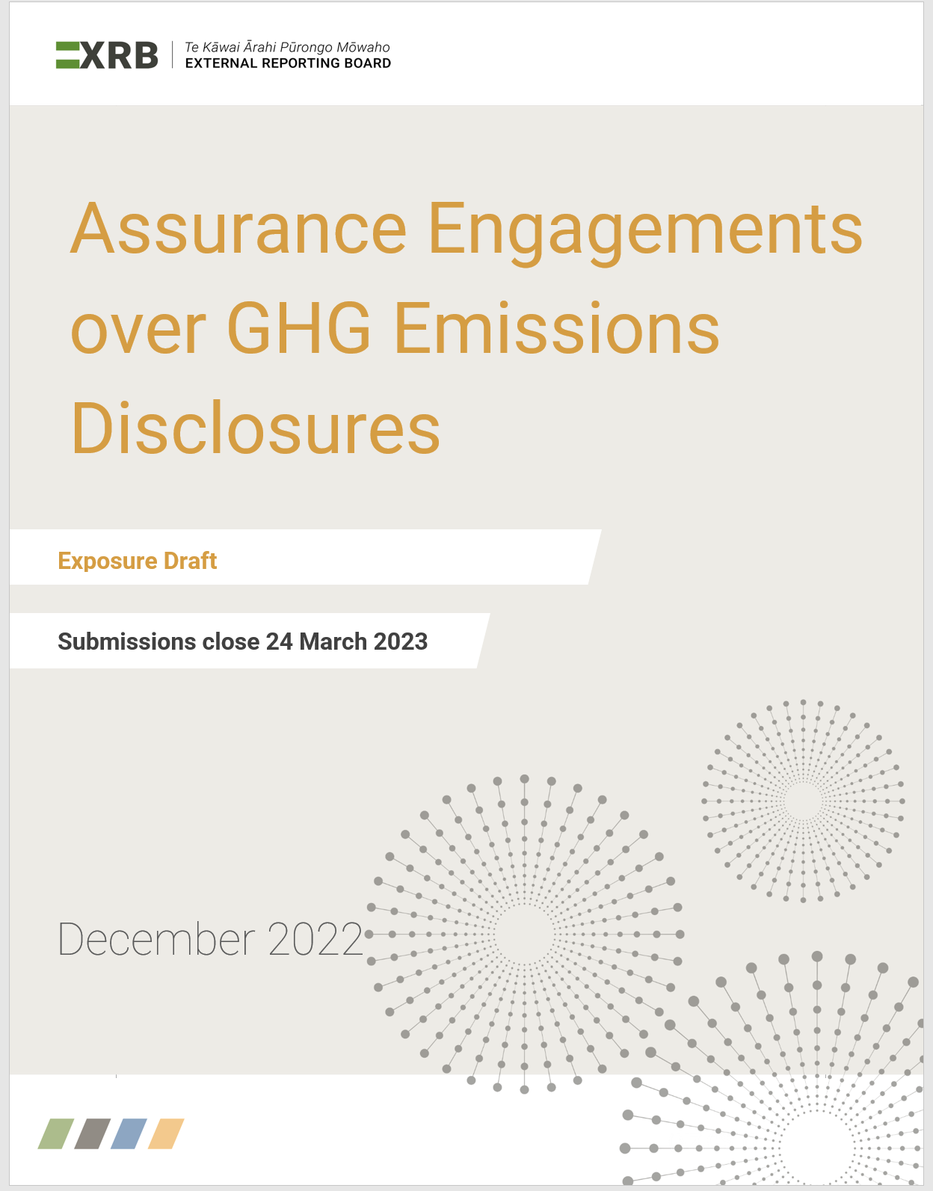
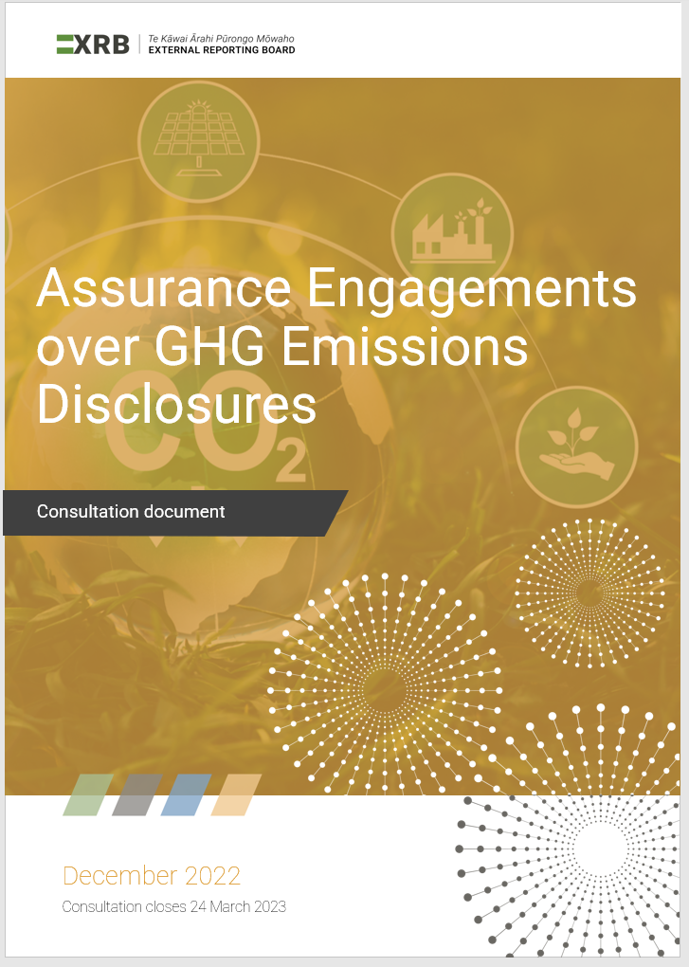
Our consultation
Assurance Engagements over GHG Emissions Disclosures
Exposure Draft
Consultation Document
Explains the approach and key questions
Proposed standard
FAQs: Assurance Engagements over GHG Emissions Disclosures
Notes:
we have issued three pieces:
1.The exposure draft which is our proposed standard
2. The consultation document – that explains the context, our approach, design principles.
We are very keen to hear what you think and ask 11 specific questions for you to think about, however if you find anything else that is important to comment please do so.
3. We have also published answers to the questions that we heard during the process of drafting the proposed standard. You can find them at the same page with ED.

Slide 7
Objectives
Standard that enables users to place trust and confidence in the mandatory GHG disclosures:
All competent and independent assurance practitioners to undertake such engagements
Drives high-quality assurance engagements
Appropriate for current regulatory regime
Notes:
Climate Reporting Entities are some of NZ most significant entities, therefore high quality and independent assurance is especially important. Our approach has been to explore and learn from multiple international standards, respecting all professionals who can contribute to high quality assurance. We build on these various international standards to ensure that the standard is locally relevant – appropriate for the unique NZ regime .
This is a new area for many, so our objective is to leverage the skills across a broad range of assurance practitioners in particular those who have expertise in GHG emissions. By doing this we will ensure that all competent, independent assurance practitioners are able to undertake these engagements.

Slide 8
Approach
This is a temporary standard.
Application date: reporting periods ending on or after 27 October 2024.
End-date: no later than periods ending on 27 October 2028.
This is a narrow scope standard.
It is applicable to assurance of GHG emissions disclosures included in climate statements required by the Financial Markets Conduct Act 2013.
Notes:
Sustainability assurance is currently rapidly evolving and assurance of GHG emissions is only a small part of the bigger and still emerging picture. The scope of mandatory assurance in New Zealand may extend to the full climate statement. In addition, an assurance licensing and oversight regime may be developed. The international assurance standards are also still in development.
Sustainability assurance is rapidly evolving and assurance of GHG emissions is only a small part of the bigger and still emerging picture. The scope of mandatory assurance in New Zealand may extend to the full climate statement. In addition, an assurance licensing and oversight regime may be developed. Various international assurance standards are also still in development. For these reasons, our current consultation proposes a temporary assurance standard which would allow GHG disclosure assurance to be undertaken by a wide range of suitably qualified practitioners.
It does not follow that to leverage diverse skills and enhance quality that we propose a temporary standard? Suggested text provides the context for the temporary nature of the proposals.
We are deliberately proposing a temporary standard meaning that the standard will have an end date while we continuously learn and explore this rapidly developing assurance space.

Slide 9
Key features of the proposals
Engagement requirements
Ethics and independence
Quality management
Require compliance with one of two international assurance standards
Include principles-based requirements
Include principles-based requirements
Include additional requirements as necessary
Professional and Ethical Standard 1
will not apply
Professional and Ethical Standards 3 and 4
will not apply
Notes:
Our standard covers three key areas:
Engagement requirements – i.e. the requirements to assure GHG information. If you are doing assurance over GHG already – you may be using an existing international assurance standard to do so- our approach is to leverage and build on the two key international standards that we are aware are currently being used in NZ.
The other two areas we address are ethis and independence and quality. The engagements standards are embedded in various professional or accreditation requirements for ethics and quality management. Given the importance of ethics, independence and quality, we propose including the key pricnipces and requirements to ensure that indepdnence is safeguarded and quality processes are inplace, regardless of which professional background the assurance practitioner may come from.. We include all of these prinicpels in one single standard speciif to this narrow scope mandatory assurance engagement rather then requiring compliance with multiple standards.

Slide 10
Engagement level
ISO 14064-3:2019
ISAE (NZ) 3410
Greenhouse gases —Part 3: Specification with guidance for the verification and validation of greenhouse gas statements
Assurance Engagements on Greenhouse Gas Statements
Or
P L U S
Various additional reporting tools and communication requirements
Notes:
We have spent time to explore and understand the various standards currently used by GHG experts in New Zealand. We found two standards are substantively similar and have informed each other over time. We therefore propose that assurance practitioners are required to follow either one of these international standards:
the ISO standard on verification and validation of greenhouse gas statements or
the New Zealand equivalent of the international standard on assurance engagements on greenhouse gas statements.
So assurance practitioner assuring the mandatory GHG emissions disclosures will need to choose will standard they follow. However, our proposed standards includes some additional reporting requirements on top of these two standards. I will talk about the reporting requirements in a minute. Before, I would like to ask you a question if you are aware of any other assurance standards that are currently used in New Zealand and which should be allowed to be used for the mandatory GHG disclosures?
If you would like to comment please raise your hand (there is this nice function in zoom) or comment in chat. And while we wait for your comments let’s run a polling question.

Slide 11
Assurance report
In addition to requirements in ISO 14064-3:2019 or ISAE (NZ) 3410:
State which assurance level was applied over which disclosures
Disclose which standards have been applied, including professional or accreditation ethical standards
Disclose other relationships held with the client
Include the name of the assurance practitioner
Notes:
The assurance report is the only visible output from the engagement. We propose some additional communication in the assurance report. We expect that these additional communication tools will help to convey the important messages from the assurance practitioner to the readers of the assurance report.

Slide 12
Assurance Reporting tools
Key Matters
Matters of most significance in the engagement
Emphasis of Matter
Highlight any GHG disclosures
Range of reporting tools
Significant Uncertainty
Highlight areas of significant uncertainty
Other Matters
Any other matter
Notes:
Our proposed standard requires to include some additional communications to the users of the assurance reports. We like to call them an auditor’s toolbox – as they are tools to help assurance practitioner to bring users attention to special matters.
These tools include: Key Matters (matters of most significance in the engagement and are relevant to users’ understanding of the assurance engagement), Emphasis of Matter paragraph (which can be used an assurance practitioner to highlight some specific aspects of GHG information disclosed by the client), Significant Uncertainty (which will be used to highlight the fact that GHG information is currently subject of significant uncertainty) and Other Matters paragraphs (that can be used to communicate for example a fact that previous year disclosures were not assured).
We would like to hear now from you what you think about the communication requirements we included in our assurance standards. Do you think they will enhance the value of the assurance report?

Slide 13
Assurance conclusions
Expect differences:
Verification wording in ISO assurance reports
Validation wording in ISO assurance reports
Some parts covered by verification and some parts covered by validation
Limited assurance
Reasonable assurance
Some parts covered by limited and some parts by reasonable assurance
Notes:
We are fully aware that by allowing the use of two international standards we will see some differences in assurance reports.
ISO practitioners will be using terms verification for historical information and validation for future oriented information. At the same time, ISAE practitioners will be just referring to assurance.
Our detailed analysis and consultation with a panel of specialists confirmed, that the same amount of work effort is required under the both suits of the standards. Therefore, even though the assurance report wording will be different in places, the same quality of work will be supporting the conclusions reached.
There will be also difference within the assurance reports issues within the same suit of standards.
Although, the climate standards require limited assurance, some entities would ask their assurance practitioners to provide reasonable assurance.
There might be also a mixture in one assurance report that some parts are covered by limited and some parts are covered by reasonable assurance.

Slide 14
Assurance conclusions
Different terminology for projected or forecast information:
Validation - ISO conclusion.
Nothing comes to our attention which causes us to believe that the assumptions do not provide a reasonable basis for the forecast. Further, in our opinion, the forecast is properly prepared on the basis of the assumptions and in accordance with [measurement criteria].
Limited assurance – ISAE conclusion.
Nothing has come to our attention that causes us to believe that the GHG disclosures are not prepared, in all material respects, in accordance with the Aotearoa New Zealand Climate Standards (NZ CSs) and [measurement criteria].
Notes:
Let’s have a closer look at differences in assurance conclusions for some parts of GHG information.
When GHG will include information that is about future – therefore it is based on assumptions – ISAE and ISO practitioners will perform similar assurance procedures to get comfort over the assumptions and methodologies that are basis for the future information. However, the relevant standards require them to issue different opinions.
This slide shows the difference in terminology applied.
Do you think that this difference would confuse the users?

Slide 15
Competence and reliance on work of others
Competence in:
Assurance skills and techniques, and
Measuring and reporting of GHG emissions
Relying on work of experts:
Evaluate competence of the expert
Evaluate objectivity of the expert
(enquire about interest and relationships)
Understand the work of the expert
Notes:
Our proposed standards includes specific requirement regarding competence and reliance on work of others.
Assurance practitioners will need to be competent both in assurance and in measuring and reporting of GHG emissions.
However, there might be times that a specialised knowledge of an expert is required and then an assurance practitioner will need to engage an expert. Although an assurance practitioner engages an external expert, it needs to have sufficient knowledge to understand the expert’s work. This includes asking appropriate questions and evaluate if answers make sense. It is important to remember that the assurance practitioner has sole responsibility for the engagement.
What is really important, an assurance practitioner will need to evaluate if it can place reliance on the work of expert. Therefore assurance practitioner will need to evaluate competence, objectivity (enquire about interest and relationships).
***
Para A24: An assurance practitioner may use the work of an expert if they conclude that the work of that expert is adequate for the assurance practitioner’s purposes. However, the assurance practitioner has sole responsibility for the engagement. That responsibility is not reduced by the work of the expert. The assurance practitioner needs to have sufficient understanding of the GHG emissions to be able to:
When needed, ask appropriate questions of the expert and evaluate whether the answers make sense in the engagement circumstances;
Evaluate the expert’s work and, to the extent needed, integrate it with the work of the engagement team as a whole; and
Take responsibility for the conclusions reached.
Para A25: When placing reliance on work undertaken by others, it is important to ensure that objectivity is not compromised. As such, it is important to consider whether others involved in the engagement have any interests or relationships that might create a self-review, self-interest, familiarity, intimidation or advocacy threat. Such considerations would normally include whether the individual has any relevant:
Financial interests;
Business and personal relationships; or
Provides any other services to the assurance client.

Slide 16
Ethics and Independence
Comply with fundamental principles:
Independence, Integrity, Objectivity, Professional Competence and Due Care, Confidentiality, Professional Behaviours.
Identify, evaluate and address threats to fundamental principles
Eliminate or reduce the threats to an acceptable level
Prohibitions:
Other important considerations
Assure own work
Prohibition on Assuming Management Responsibility
Financial Interest Prohibition
Conditions and Relationships
Addressing Familiarity Threat due to Long Association
Notes:
This slide tries to summarise ethics and independence section of our proposed standard:
The overall concept is well known to all assurance practitioners: fundamental principles, threats, elimination or reducing them to acceptable level
Specific prohibitions
Other important considerations.
We have included specific prohibitions and other important considerations based on feedback from those of you who have been with us on the journey of developing the standard. Assurance practitioners were especially concerned about these aspects, therefore we included them either as prohibitions or specific prompts in our standards. We tried to be principle based, concise and straightforward. Therefore we opted for just the basics, the most important pieces in the standard, and more to be included in FAQ.
Any questions/or comments on the ethics and independence proposals?
So to sum it up tell us what you think about the ethics and independence section of our standard.
Can you respond to the poll that is now on your screen?
We are wondering if you are able to confirm that the section looks fine for you and it is appropriate in the context of the standard that is built for this specific GHG regime.
If you think the section is missing something please let us know in the chat or after the webinar please reach out to us. (remember this is a feedback forum – hoping it was set up as a meeting so that participants are able to actually ask a question or express a view
We recognise that some of you might not have chance to read the documents in full so if you think you still need to think about this, please reach out to us at your convenience before 24 March and let us know your thoughts.

Slide 17
Quality Management
The overall system of quality management
Engagement Performance
Independent review
Consultation
Notes:
The proposed standard includes quality management requirements. These require:
a system of quality management, including a risk assessment process and requiring a monitoring and remediation process
engagement performance requirements to ensure high quality engagements
consultation on difficult or contentious matters and
requires there to be an independent reviewer on every engagement.
This approach builds on principles included in various international equivalent assurance standards.

Slide 18
Other comments
Overall, the standard looks fine to me.
It is missing some important aspects…
…and I will inform you in my submission/email/chat/any other form.
Difficult to say. I will need to think about this more and...
…and will come back in my submission/email/any other form.
Polling question:
Is there anything else important that is missing in the proposed standard?

Slide 19
How to Comment
You can provide feedback to us via:
Our website:
Assurance over GHG Emissions Disclosures » XRB
Email us assurance@xrb.govt.nz
Comment on LinkedIn
linkedin.com/
company/
external-reporting-board
Comments are due by 24 March 2023
16 December 2022
ED Published on XRB Website
8 February 2023
Virtual Feedback Forum
24 March 2023
Comment period closes
July/Aug 2023
Issue standard
October 2024
GHG disclosures subject to mandatory assurance
Notes:
Thank you
Ma te wa

Slide 20
Where to from here…..
MBIE/MfE consultation covers:
Occupational licensing for assurance practitioners
Expanding assurance to cover the whole climate statement.
Submissions close 10 February 2023
Notes:
Whether occupational licensing for assurance practitioners should be introduced and, if so, what form that licensing should take
If the assurance requirement should be expanded to cover the whole climate statement.

