Slide 1
Kia Toipoto Gender & Pay Gap Action Plan 2023

Slide 2
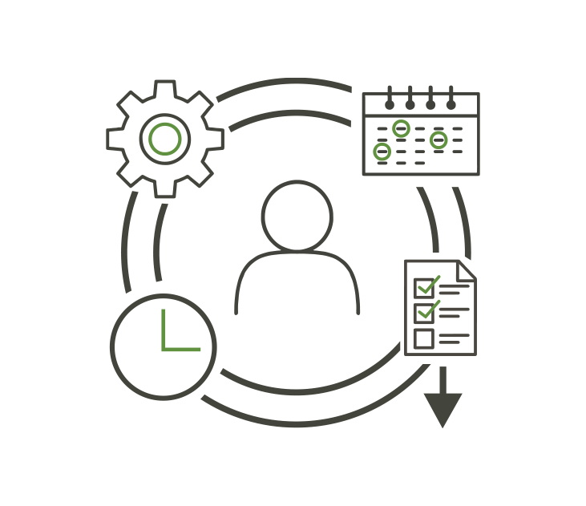
Current Status
Gender and pay
Gender of employees
There are currently more women than men in our workforce and more women in leadership roles.
The gender pay gap has declined from the previous year.
23 Women
9 Men
Gender of employees in senior roles
5 Women
1 Man
Equal Pay
Remote work opportunities
We offer flexible work. We have a mixture of employees who work remotely and from various offices located throughout New Zealand.
All employees are provided the necessary equipment to perform their job.
Flexible Work

Slide 3
Current Status (continued)
Inclusivity
Leadership roles
We continuously aim to create an inclusive environment by ensuring our HR policies are regularly reviewed and initiating the collection of demographic data.
The majority of our leadership roles are held by women. We have recently implemented a new performance review system to help us to promote more diverse leadership opportunities.
No Bias or Discrimination
Gender balanced
leadership
83.33%
16.67%
FEMALE
MALE
Diversity
We recognise the importance of diversity within organisations. As a small organisation, any changes in staffing can result in skewed data however, in 2023 we have commenced the collection of ethnicity data as a starting point. Our aim is to use this data to assess the existence of any workplace barriers which may be limiting our diversity as an organisation.

Slide 4
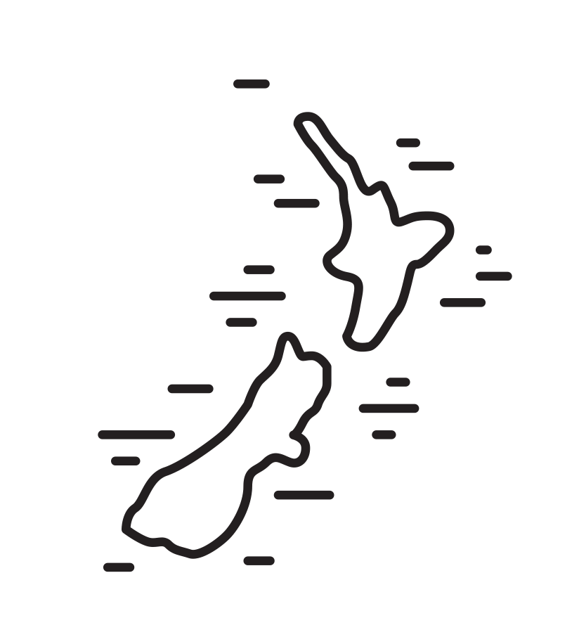
MyHR System Rollout
Te Reo Māori
Our new MyHR system will help to improve our processes, including records management and employee data collection.
We will seek out opportunities to use Te Reo Māori and continue to acknowledge the cultural value it has within Aotearoa New Zealand.
Actionable Steps
Equal Pay
Flexible Work
No Bias or Discrimination
Gender Balanced Leadership
We will annually review gender and ethnic pay gaps.
This review will help us to identify any gaps and take proactive steps to remove them.
We will continue to offer flexible working solutions to support our employees.
We will provide all necessary equipment for them to perform their duties.
When reviewing our policies and practices, we will consider our gender and ethnicity data.
This review will help us to tailor an unbiased recruitment process.
Our MyHR software will help to identify any gaps within our workforce.
Our performance review system will help us to promote career pathways.

Slide 5
Digging Deeper
Moving forward we will annually publish Kia Toipoto action plans to our website.
1
2
3
4
5
Introduce the new MyHR system to staff
Begin collecting employee data
Review this data and identify any potential issues
Create a plan to correct these issues
Record and share this information on our website

